Slide 1


Summer Training Project on:- ALL SPACE MISSIONS FROM 1957
Submitted To: Submitted By:
Mr. Prateek Gupta Priyansh Garg (06390302021)
(ShapeMySkills) Kashish (05590302021)

Slide 2
Objective
So as we know that every country conducts several space mission in order to gain more information and share that information with other countries in order become powerful, so these mission are very crucial for any country as it requires great resources, funds and time to complete and still there is no certainty for success, so the aim of my project is to consider some factors which may affect the success of any space mission and find any pattern or trend which can help in the success of future missions.

Slide 3




Tools Used:
Python:- Python is a high-level, general-purpose programming language. Its design philosophy emphasizes code readability with the use of significant indentation
Machine Learning:-Machine Learning is the field of study that gives computers the capability to learn without being explicitly programmed. ML is one of the most exciting technologies that one would have ever come across.
Tableau:- Tableau products query relational databases, online analytical processing cubes, cloud databases, and spreadsheets to generate graph-type data visualizations. The software can also extract, store, and retrieve data from an in-memory data engine.
Jupyter Notebook:- Jupyter Notebook (formerly IPython Notebook) is a web-based interactive computational environment for creating notebook documents.

Slide 4
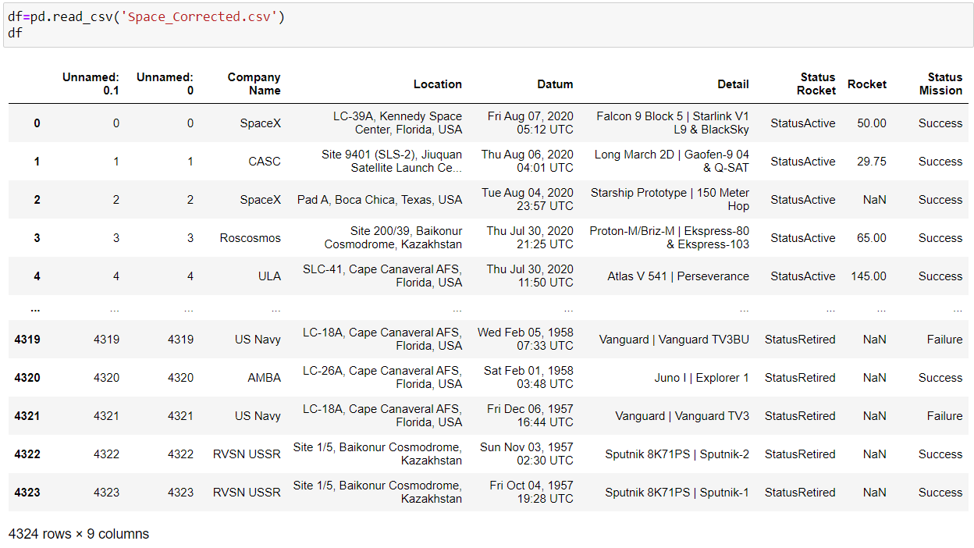
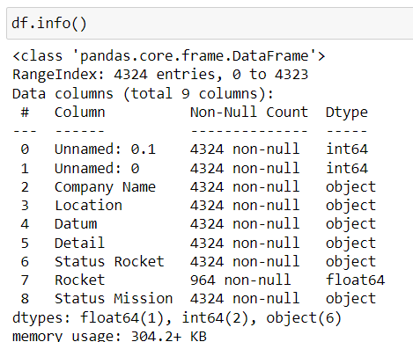
Dataset

Slide 5

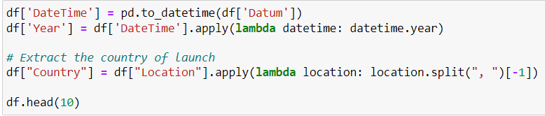



Cleaning of Data
Dropping Unwanted Columns: Extracting Useful data from a Column:
Checking and Filling Null Values: Renaming the columns:

Slide 6
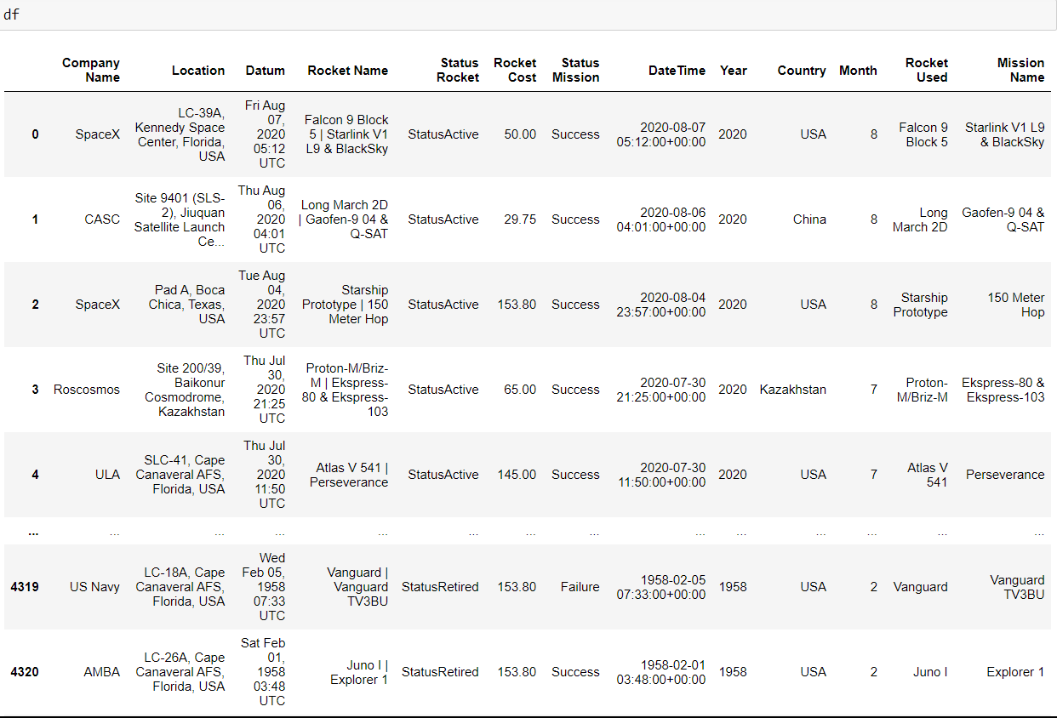
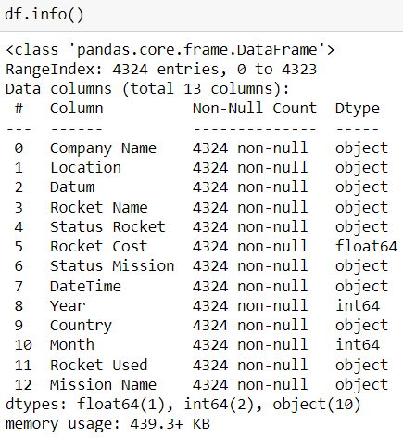
Dataset After Cleaning

Slide 7
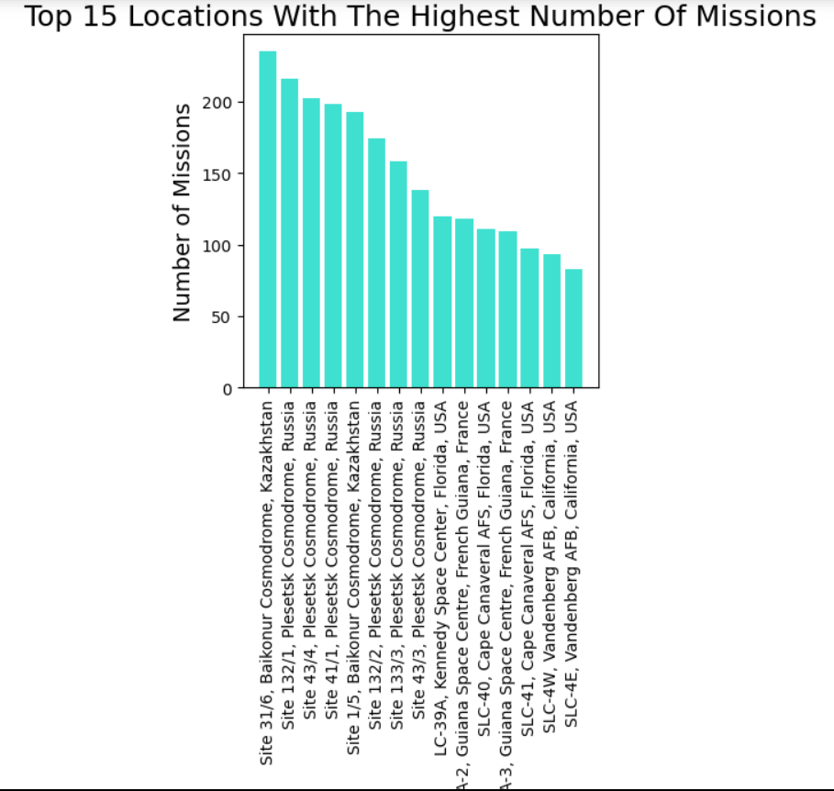
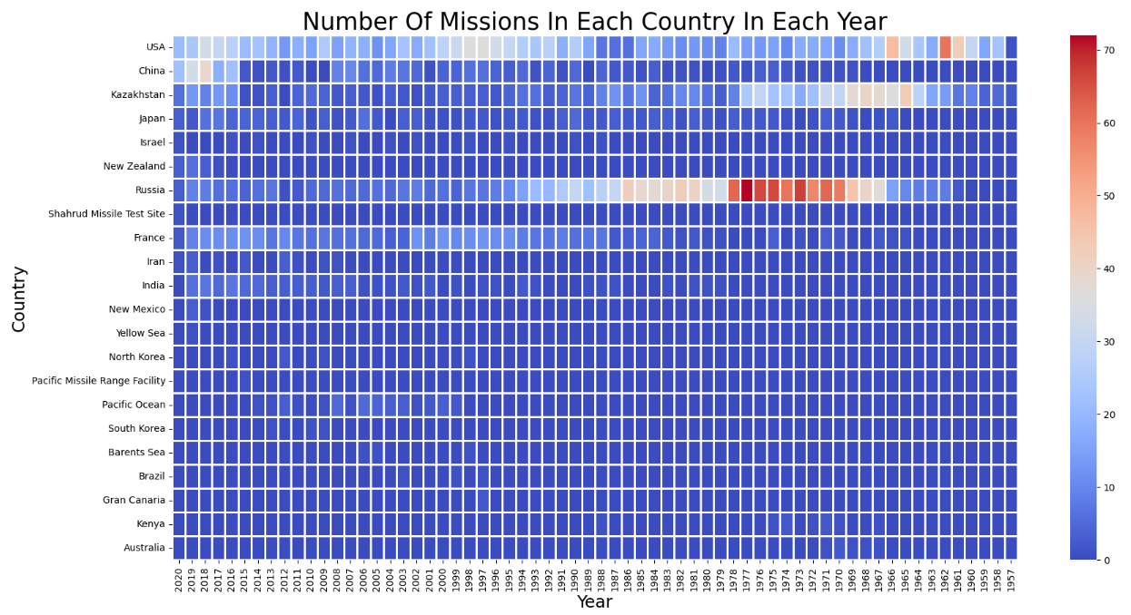
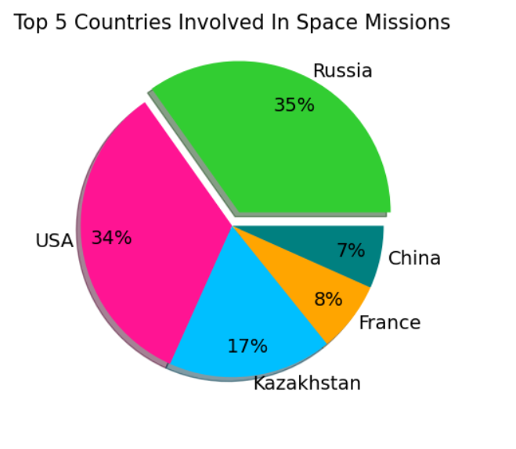
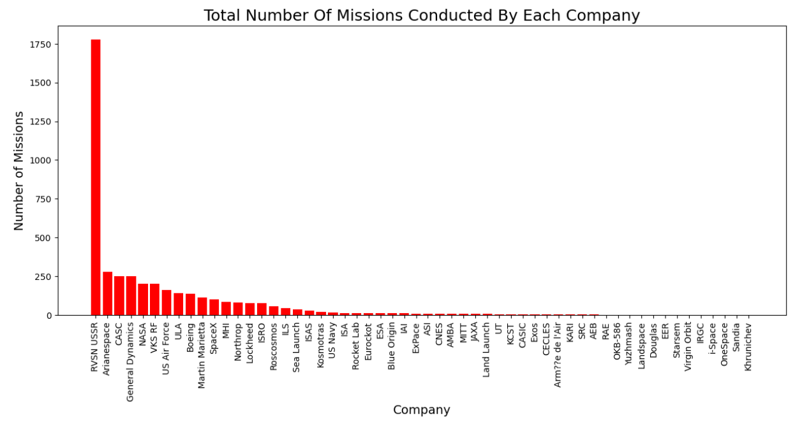
Data Visualisation

Slide 8
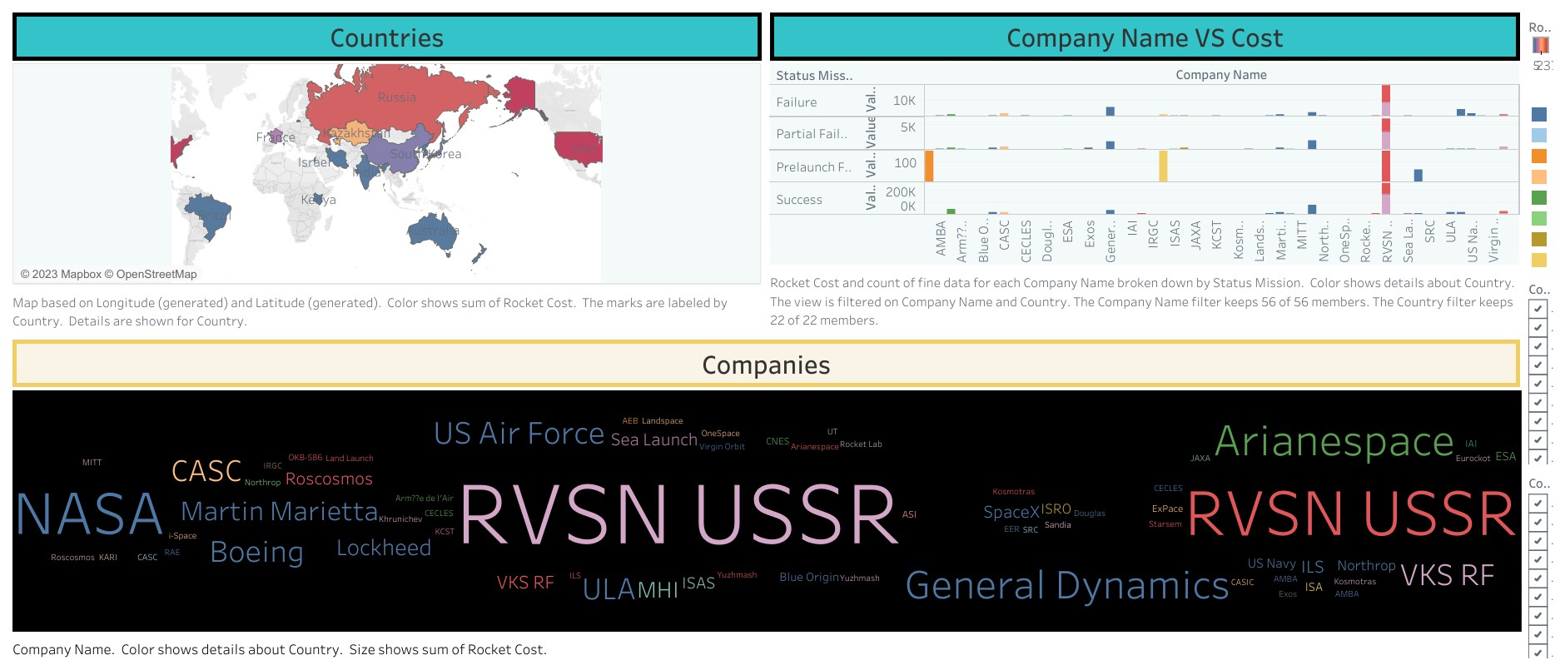
Dashboard #1
Tap to visit Dashboard

Slide 9
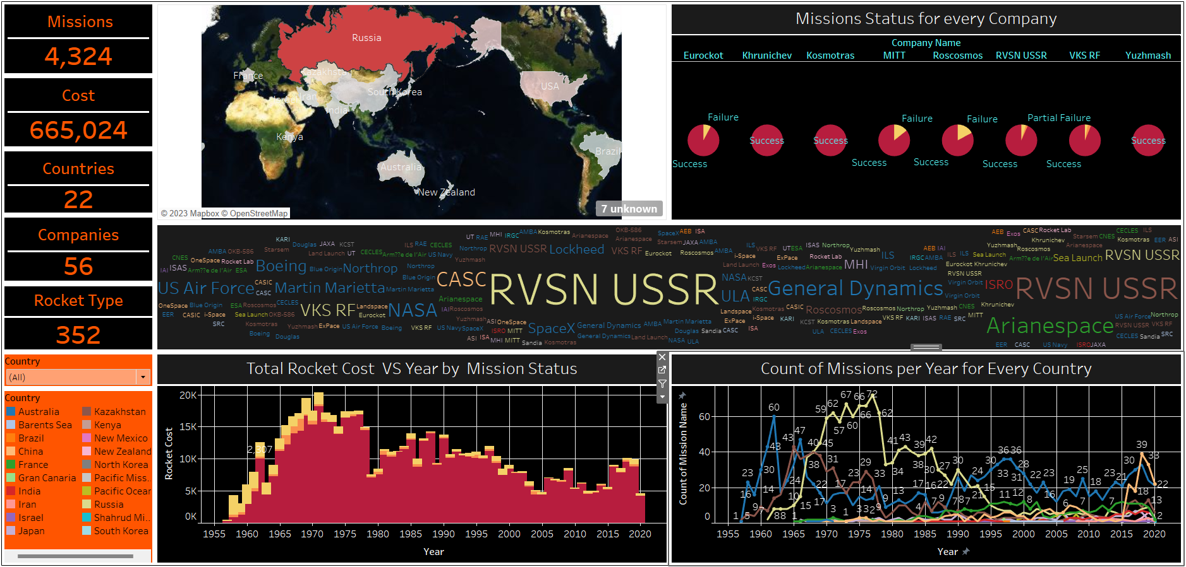
Dashboard #2
Tap to visit Dashboard

Slide 10
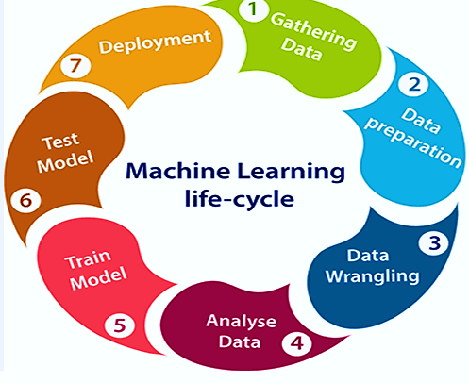
Machine learning process

Slide 11
Algorithm Used (Logistic Regression)
LOGISTIC REGRESSION –Logistic regression is used for solving the classification problems. It predicts the output of a categorical dependent variables. Therefore the outcome must be a categorical or discrete value.
STEPS IN LOGISTIC REGRESSION:
Data pre-processing
Splitting Dataset into Set and Target
Fitting logistic regression to the training set
Predicting the test result
Test accuracy of the result

Slide 12
Why using logistic regression model in the dataset?
Our Dataset set contains more categorical data and object type data
This model is easier to implement, interpret and very efficient to train
It provides coefficients for each feature, which allows you to interpret the impact of each feature on the probability of the positive class.
The independent variables of our dataset are weakly corelated which makes this model more suitable.

Slide 13
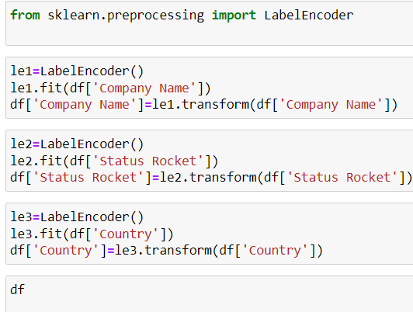
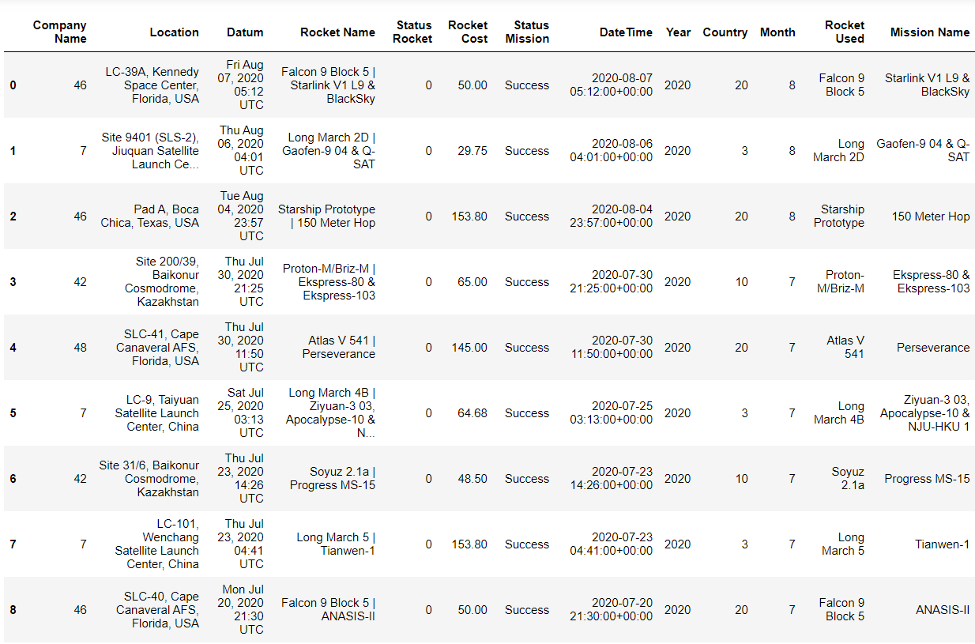
Data Pre-Processing

Slide 14

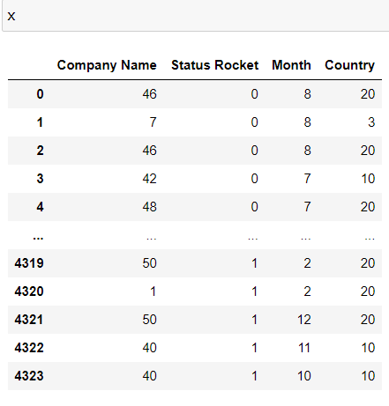
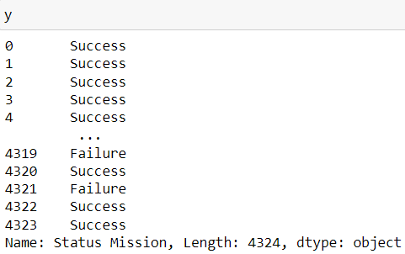
Splitting Dataset into Set and Target

Slide 15
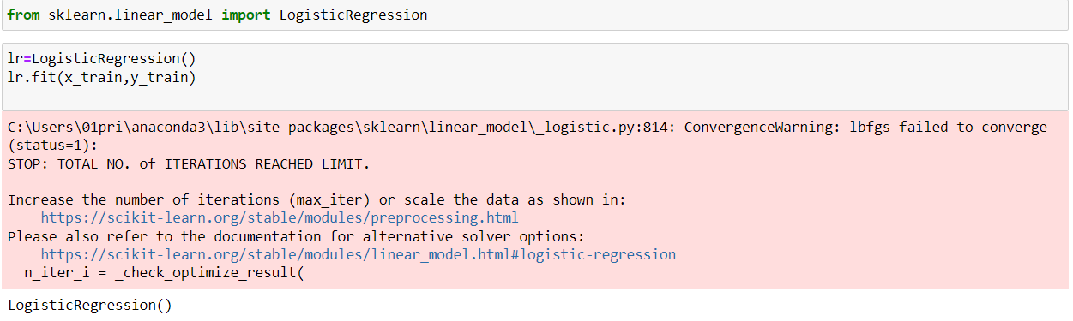
Applying Model and Training

Slide 16
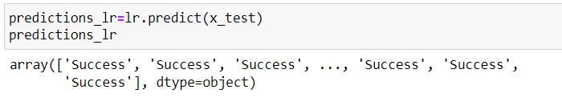
Prediction
Our Model predicts that whether the Mission is going to be a SUCCESS, PARTIAL FAILURE or FAILURE by considering the Company involved, Country where mission is taking placed, Month for the launch and Status of the Rocket which is being used.

Slide 17
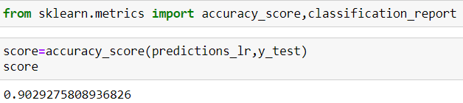
Checking Accuracy
Results Predicted by our Model are 90% Accurate

Slide 18
Comparison Of Accuracy (Logistic Regression)
TEST SIZE | RANDOM STATE | ACCURACY
0.20 | 40 | 90.05%
0.5 | 42 | 89.82%
0.20 | 90 | 89.25%
0.30 | 90 | 90.29%

Slide 19
Comparison Of Accuracy (Decision Tree Classifier)
TEST SIZE | RANDOM STATE | ACCURACY
0.20 | 40 | 88.61%
0.5 | 42 | 88.15%
0.20 | 90 | 88.78%
0.30 | 90 | 89.36%

Slide 20
Comparison Of Accuracy (Random Forest Classifier)
TEST SIZE | RANDOM STATE | ACCURACY
0.20 | 40 | 89.13%
0.5 | 42 | 89.31%
0.20 | 90 | 88.67%
0.30 | 90 | 90.27%

Slide 21
Comparison For Best Model With Most Accuracy
MODEL USED | TEST SIZE | RANDOM STATE | ACCURACY
Logistic Regression Classifier | 0.30 | 90 | 90.29%
Decision Table Classifier | 0.30 | 90 | 89.36%
Random Forest Classifier | 0.30 | 90 | 90.27%

Slide 22
Future scope
Analyzing the trends in space missions over time can provide insights into the growth of space exploration, technological advancements, and shifts in mission objectives.
Investigate the factors that contribute to mission success or failure.
Analyze the impact of international collaborations on space missions.
Develop predictive models to forecast future trends in space missions based on historical data.

Slide 23


